Slide 1



Data Science and Machine Learning
Generative AI II

Slide 2
Retrieval augmented generation (RAG)

Slide 3
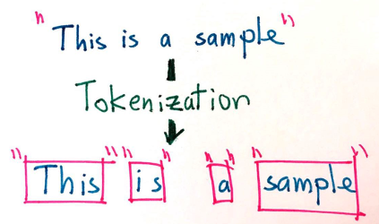
Embeddings from words to numbers
Tokenization is the act of splitting strings into lists of “tokens” (not words, but very close)

Slide 4
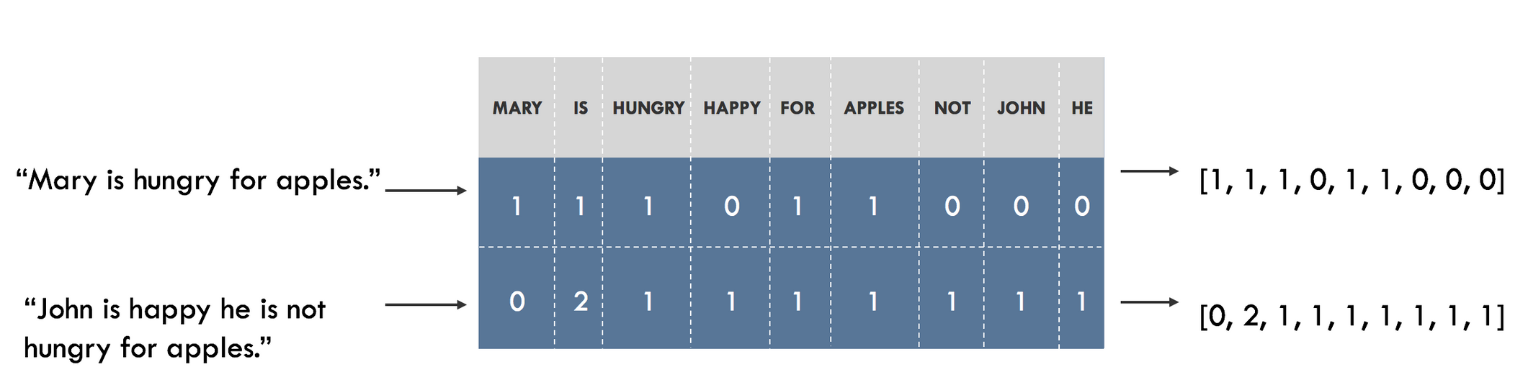
Embeddings from words to numbers

Slide 5
Embeddings from words to numbers
What if we could represent the words via its “meaning” and not its letters?
Using only “letters”
User query: “Someone in my class had a question!
No Match
Student
Lab
Exercise

Slide 6
Embeddings from words to numbers
Student
Lessons
Teachers
Assignments
Exercises
Slides
The classroom dashboard integrates data from Students and Teachers to display attendance and grades. Teachers use the platform to assign Exercises and Lessons to Students. Labs provide practical exercises that complement the theoretical Lessons. Slides are used by Teachers during Lessons to illustrate key points. Assignments are tracked and graded by Teachers, with results available to Students. Quizzes are periodically given to assess Students' understanding of the material. The curriculum outlines the sequence of Lessons and Labs for the term. Attendance is monitored daily and logged by Teachers. Grades are calculated based on performance in Assignments, Quizzes, and Labs. Students can view their progress in real-time on their dashboard. Teachers use data from Lessons and Quizzes to tailor future Exercises and Assignments.
"Where can I find the slides for today's lesson?" "How do I submit my assignment?" "What exercises should I complete for the lab session?" "Can I review my grades for the last quiz?" "How is attendance being tracked in our classroom?" "Is there a way to see the curriculum for this semester?" ""How are grades calculated from quizzes and assignments?" "Can the teacher see which students have completed the exercises?"
Labs
Grades
Curriculum
Attendance
Quizzes

Slide 7
Embeddings from words to numbers
Assignments
Student
Grades
Curriculum
The classroom dashboard integrates data from Students and Teachers to display attendance and grades. Teachers use the platform to assign Exercises and Lessons to Students. Labs provide practical exercises that complement the theoretical Lessons. Slides are used by Teachers during Lessons to illustrate key points. Assignments are tracked and graded by Teachers, with results available to Students. Quizzes are periodically given to assess Students' understanding of the material. The curriculum outlines the sequence of Lessons and Labs for the term. Attendance is monitored daily and logged by Teachers. Grades are calculated based on performance in Assignments, Quizzes, and Labs. Students can view their progress in real-time on their dashboard. Teachers use data from Lessons and Quizzes to tailor future Exercises and Assignments.
"Where can I find the slides for today's lesson?" "How do I submit my assignment?" "What exercises should I complete for the lab session?" "Can I review my grades for the last quiz?" "How is attendance being tracked in our classroom?" "Is there a way to see the curriculum for this semester?" ""How are grades calculated from quizzes and assignments?" "Can the teacher see which students have completed the exercises?"
Lessons
Teachers
Labs
Exercises
Slides
Attendance
Quizzes

Slide 8
Embeddings from words to numbers
Assignments
Student
Grades
Curriculum
The classroom dashboard integrates data from Students and Teachers to display attendance and grades. Teachers use the platform to assign Exercises and Lessons to Students. Labs provide practical exercises that complement the theoretical Lessons. Slides are used by Teachers during Lessons to illustrate key points. Assignments are tracked and graded by Teachers, with results available to Students. Quizzes are periodically given to assess Students' understanding of the material. The curriculum outlines the sequence of Lessons and Labs for the term. Attendance is monitored daily and logged by Teachers. Grades are calculated based on performance in Assignments, Quizzes, and Labs. Students can view their progress in real-time on their dashboard. Teachers use data from Lessons and Quizzes to tailor future Exercises and Assignments.
"Where can I find the slides for today's lesson?" "How do I submit my assignment?" "What exercises should I complete for the lab session?" "Can I review my grades for the last quiz?" "How is attendance being tracked in our classroom?" "Is there a way to see the curriculum for this semester?" ""How are grades calculated from quizzes and assignments?" "Can the teacher see which students have completed the exercises?"
Lessons
Teachers
Are the assignments mandatory?
Labs
Exercises
Slides
Attendance
Quizzes

Slide 9
Embeddings from words to numbers
Assignments
Student
Grades
Curriculum
Lessons
Are the assignments mandatory?
Teachers
Are the assignments mandatory?
Docname; source
Docname;source
Docname;source
Docname;source
Docname;source
Docname;source
Labs
Exercises
Slides
Attendance
Quizzes

Slide 10
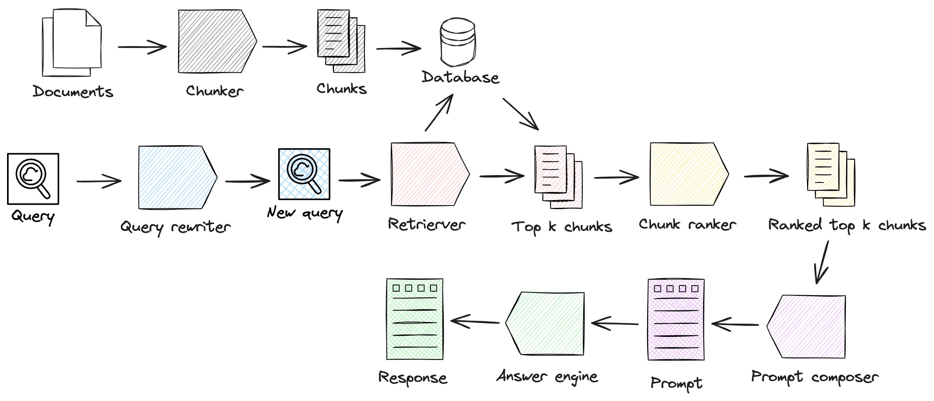
Embeddings from words to numbers
Retriever step

Slide 11
RAG Retrieved Augmented Generation
Retriever step
Generation step

Slide 12
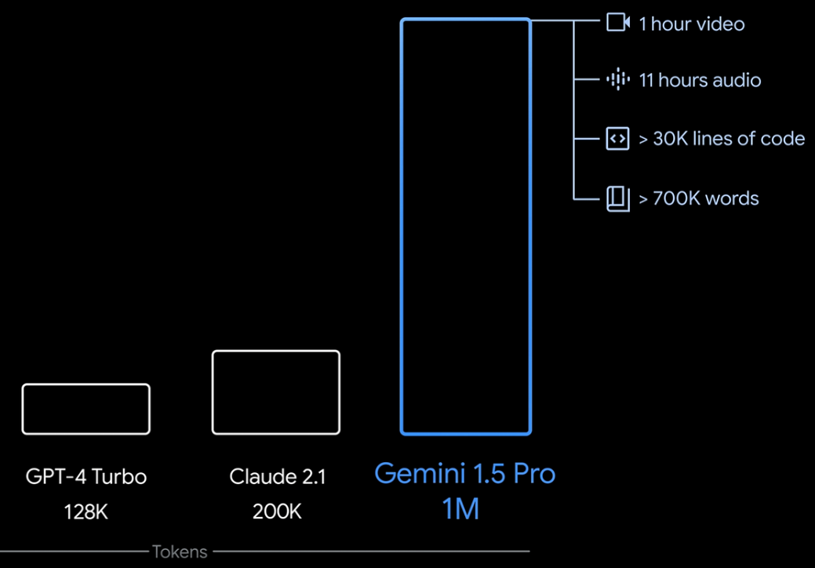
RAG

Slide 13
Why is RAG so useful?

Slide 14

Knowledge cut-offs in LLMs
Prompt
Model
Completion
Who is the current Prime Minister of the United Kingdom?
Who is the current Prime Minister of the United Kingdom?
Boris Johnson
LLM

Slide 15









LLM-powered applications
LLM
External Data Sources
User Application
Orchestration library
Documents
Database Web
External Applications

Slide 16




Retrieval Augmented Generation (RAG)
External information sources
Query encoder
LLM
Retriever

Slide 17



Example: Searching legal documents
Input query
UNITED STATES DISTRICT COURT SOUTHERN DISTRICT OF MAINE
CASE NUMBER: 22-48710BI-SME
Busy Industries (Plaintiff) vs.
State of Maine (Defendant)
UNITED STATES DISTRICT COURT SOUTHERN DISTRICT OF MAINE
CASE NUMBER: 22-48710BI-SME
Busy Industries (Plaintiff) vs.
State of Maine (Defendant)
Who is the plaintiff in case 22-48710BI-SME?
Who is the plaintiff in case 22-48710BI-SME?
documents
Query Encoder
External Information Sources

Slide 18

Example: Searching legal documents
UNITED STATES DISTRICT COURT SOUTHERN DISTRICT OF MAINE
CASE NUMBER: 22-48710BI-SME
Completion
Busy Industries (Plaintiff) vs.
State of Maine (Defendant)
Busy Industries
LLM
Who is the plaintiff in case 22-48710BI-SME?

Slide 19
RAG integrates with many types of data sources
External Information Sources
Documents
Wikis
Expert Systems
Web pages
Databases
External information sources
Query encoder
Vector Store
Retriever

Slide 20

Data preparation for vector store for RAG
Two considerations for using external data in RAG:
1. Data must fit inside context window
Prompt context limit few 1000 tokens
Single document too large to fit in window
Split long sources into short chunks

Slide 21
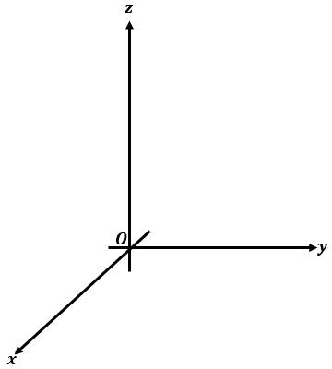


Data preparation for RAG
Two considerations for using external data in RAG:
Data must fit inside context window
Data must be in format that allows its relevance to be assessed at inference time: Embedding vectors
fire
Prompt text converted to embedding vectors
book
jumps
X₁
X₂
X₃
X₄
X₅
fox
swim
whale
Cosine similarity

Slide 22

Data preparation for RAG
Two considerations for using external data in RAG:
Data must fit inside context window
Data must be in format that allows its relevance to be assessed at inference time: Embedding vectors
Process each chunk with LLM to produce embedding vectors
X₁
X₂
X₃
X₄
X₅
X₆
X₁
X₂
X₃
X₄
X₁
X₂
X₃
X₄
X₅
X₁
X₂
X₃
X₄
X₅
X₆
X₇

Slide 23


Vector database search
Text 1
Each text in vector store is identified by a key
Enables a citation to be included in completion
Text 5
Text 2
Prompt
Text 4
Text 6
Text 3

Slide 24
RAG (Retreived Augmented Generation) Bring it all together

Slide 25
RAG (Retreived Augmented Generation) Bring it all together
Retreiver step
Generation step

Slide 26
RAG (Retreived Augmented Generation) Bring it all together
prompt = f"""
## INTRODUCTION
You are a Chatbot designed to help answer technical questions about the software at BNPP.
The user asked: "{user_question}"
## CONTEXT
Technical Documentation for the software:
'''
{_get_document_prompt(docs)}
'''
## RESTRICTIONS
Refer to the products by their names.
Be clear, transparent, and factual: only state what is in the context without providing opinions or subjectivity.
Answer the question based solely on the context above; if you do not know the answer, be clear with the user that you do not know.
Only respond to questions related to the products, avoiding jokes, offensive remarks, and discussions on religion or sexuality.
If the user does not provide sufficient context, do not answer and instead ask for more information on what the user wants to know.
## TASK
First, answer directly to the user, if possible
Second, point the user int he right direction of the documentation
## RESPONSE STRUCTURE:
'''
[answer text]]
Source:
• From pages [...] of the Technical Documentation for *Product1* (link)
• From pages [...] of the Technical Documentation for *Product2* (link)
'''
## CONVERSATION:
User: {user_question}
Agent:
"""

Slide 27
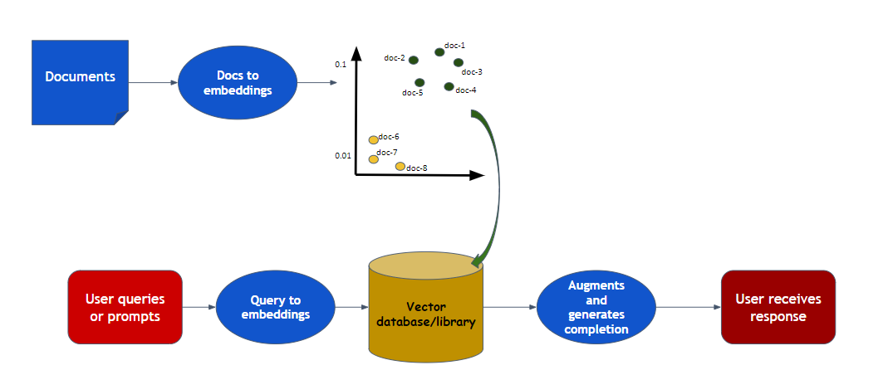
RAG (Retreived Augmented Generation) Bring it all together

Slide 28
Lets code this out?

Slide 29
RAG (Retreived Augmented Generation) Bring it all together
Retreiver step
Generation step

